Slide 1
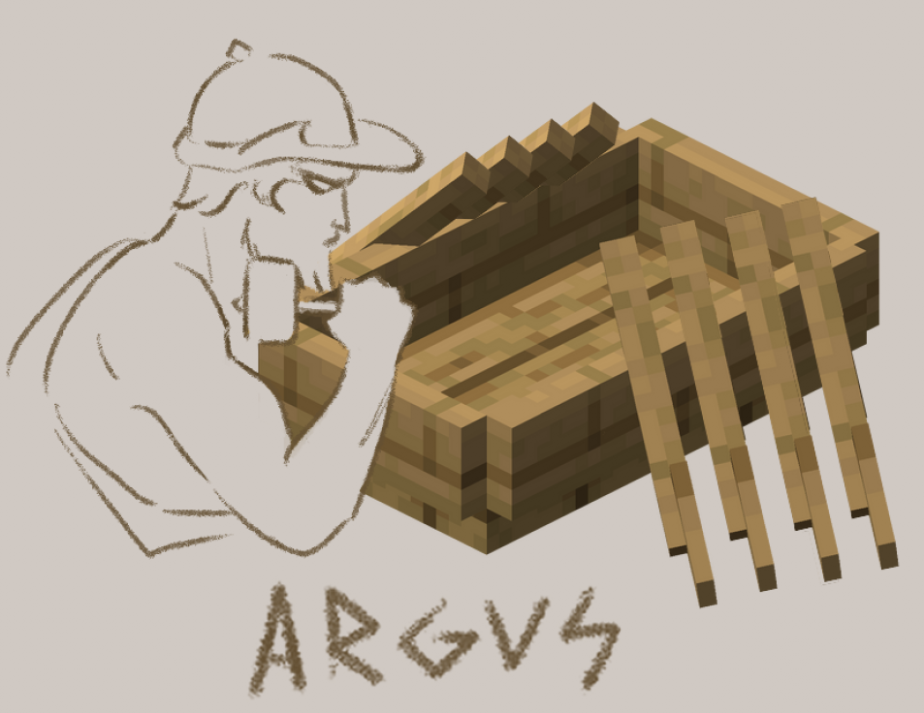
Argus - A BDI MULTI-AGENT MINECRAFT environment
by Bardia Parmoun
MASc Electrical and Computer Engineering
COMP 5900

Slide 2
01
Introduction

Slide 3

Motivation
Lack of complex multi-agent applications for the BDI design paradigm
What would BDI-MAS strategies look like?
What are some successful strategies?

Slide 4
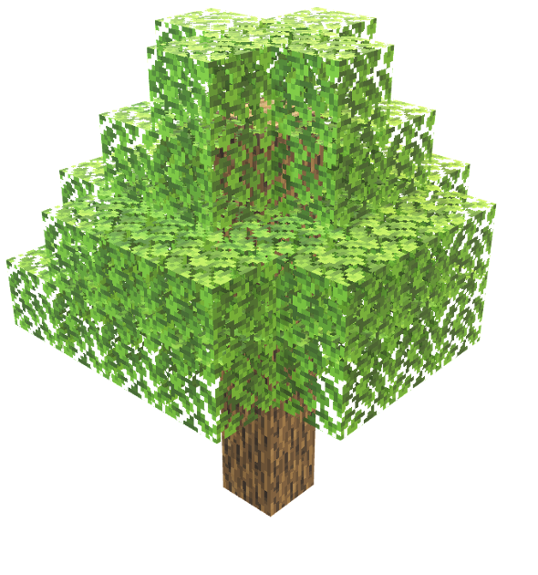
Problem Description
Objectives:
Autonomous NPCs vs zombies
Survive the game and collects points
Rules:
can attack the zombies and other NPCs
games run for 1.5 minutes
can chop trees and collect wood
can build houses to hide and recover (can fit 2 players at a time)
can form alliances
-> share houses, donate wood, protect each other

Slide 5
02
Background

Slide 6
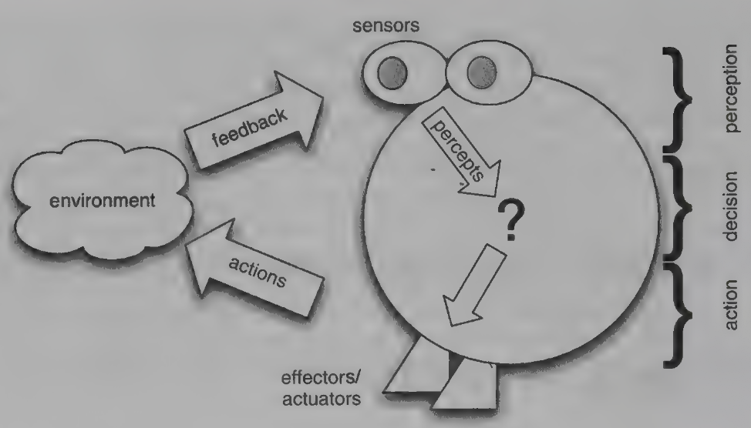
What are BDI agents?
“An agent is a computer system, situated in some environment, that is capable of flexible autonomous action in order to meet its design objectives” - Jennings et al
Autonomous robots are a great example!
Popular ways to design robots: imperative programming, state machines, subsumption architecture, etc.
Proposing BDI:
BELIEFS: agent’s knowledge about the world
DESIRES: the goals for the agent
INTENTIONS: agent’s plans to for achieving its goals

Slide 7
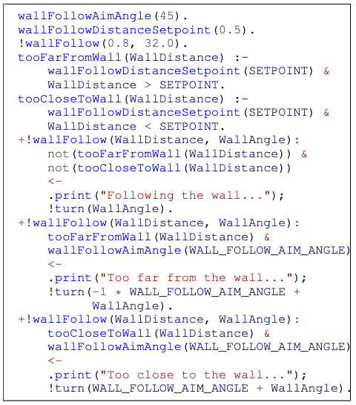

How to Write BDI agents?
Beliefs
AgentSpeak: a theoretical formal language for BDI
Formal notation for agent’s beliefs, goals, and plans
Jason: one of its most popular implementations!
The agent repeatedly perceives, reasons, and acts!
Goals
Rules
Plans
Jason example!

Slide 8
03
The Model

Slide 9
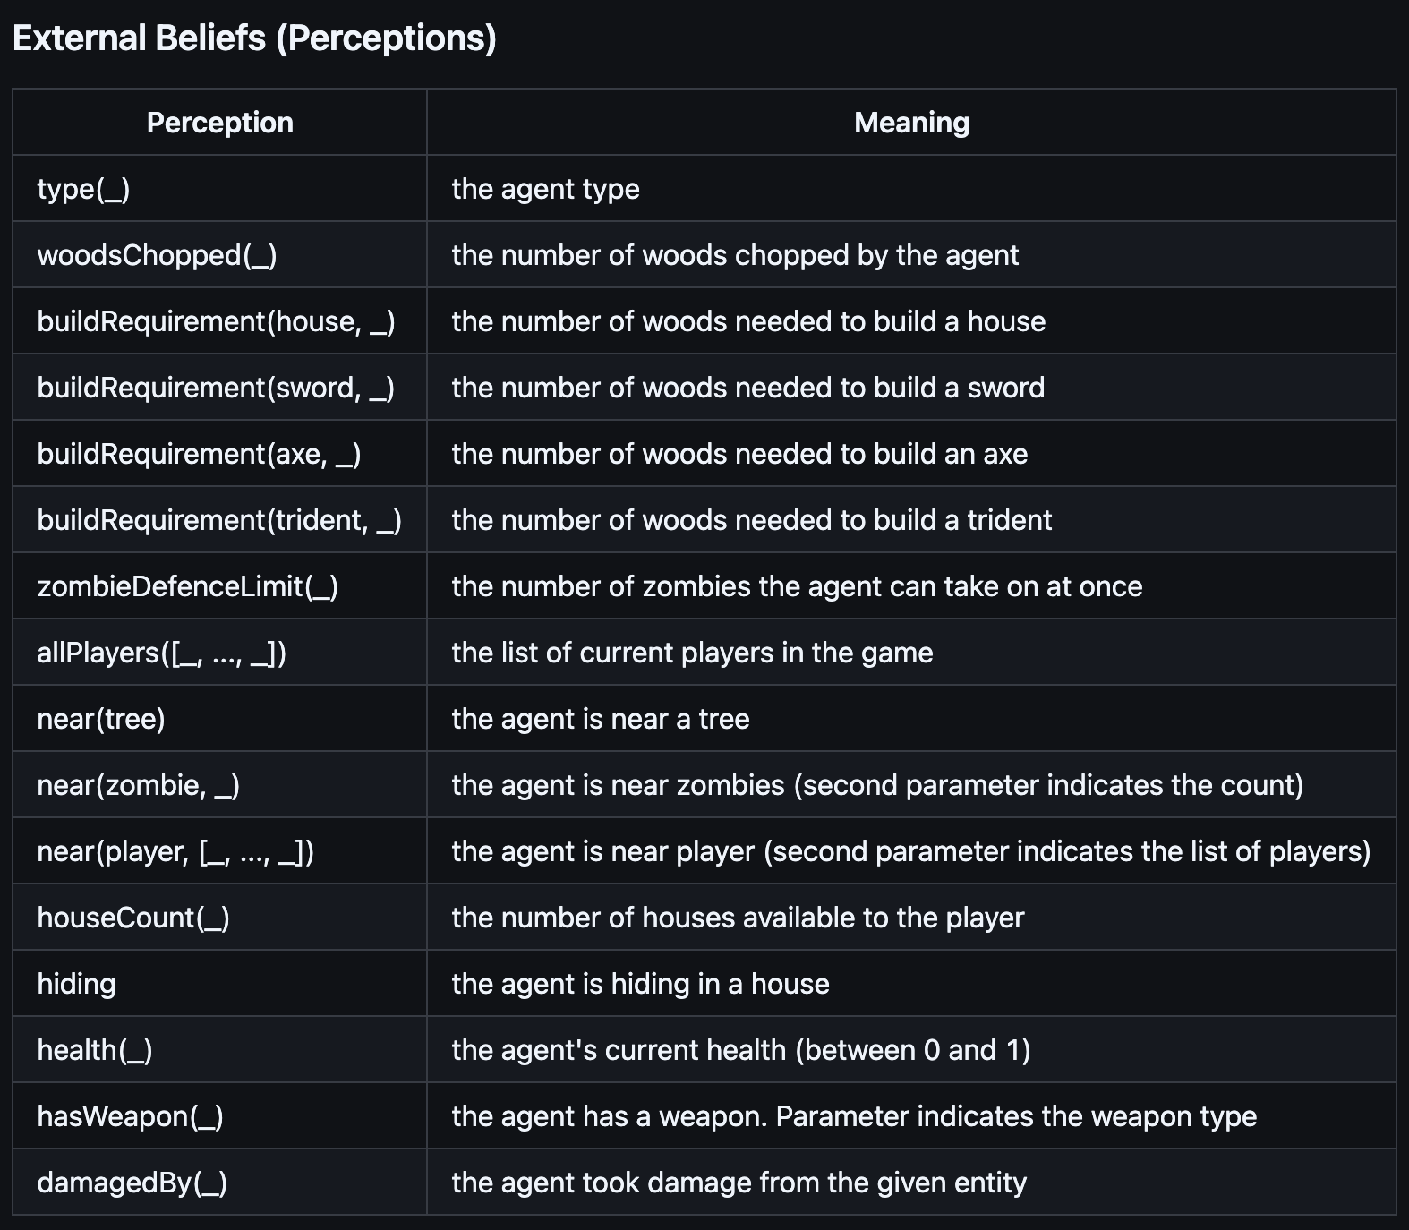
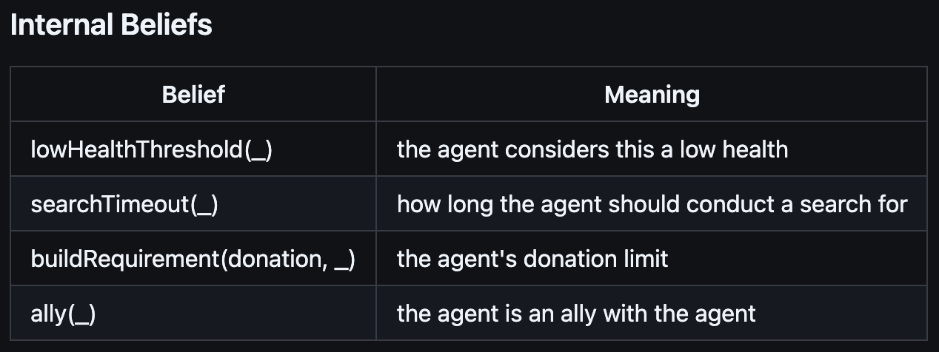
Agent Beliefs

Slide 10
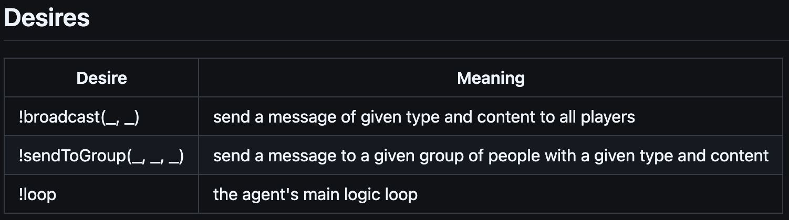
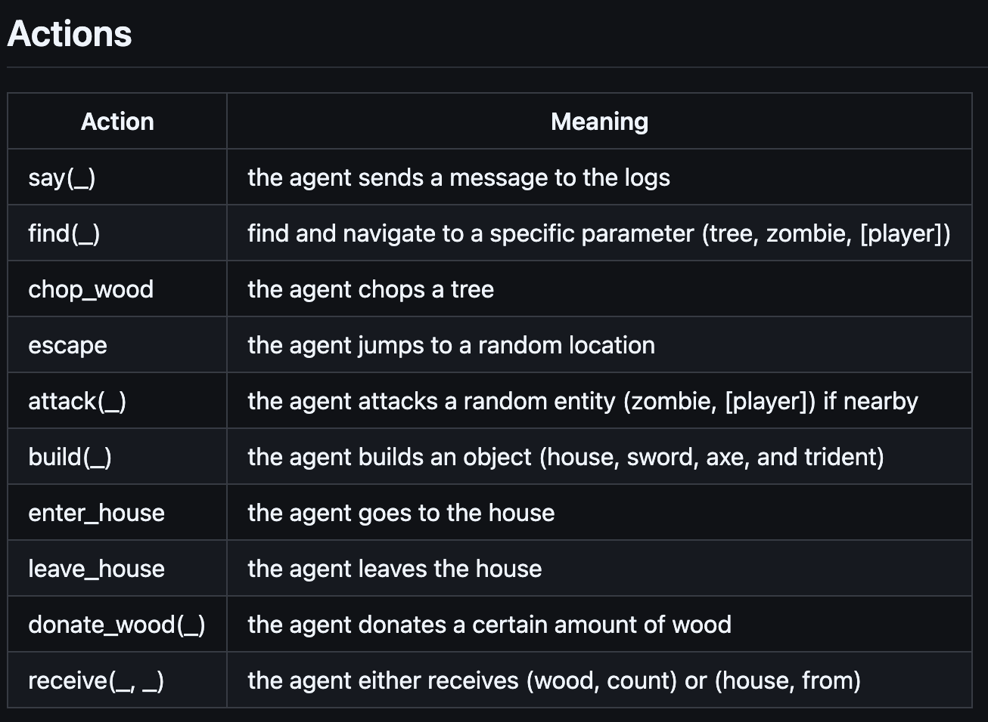
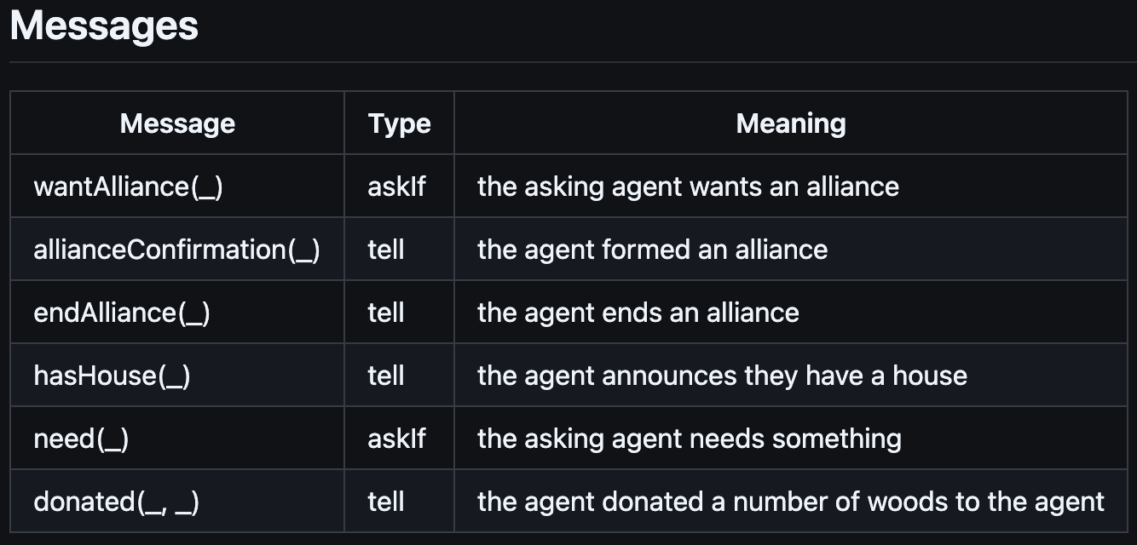
Agent Abilities

Slide 11
Weapons and scores
weapons | Cost (in woods) | # entities to attack | escape range (in blocks)
nothing | 0 | 1 | 10
SWORD | 10 | 2 | 8
AXE | 15 | 3 | 6
Trident | 20 | 4 | 4
Activity | Cost (in woods) | Reward (In woods)
build house | 12 | 500
attack zombie (per attack) | 0 | 25
Donate | 2 (DEFAULT) | 50
survive | 0 | 10000/[# PLAYERS]

Slide 12
Proposed strategies
Capitalist
try to build as many houses as possible
only buy swords for weapons after having at least one house
Shares the houses with the allies and donate wood to them
Attack zombies
Find and attack non allies only if has sword
Attacker
try to buy a sword first
try to build a house after
upgrade weapon to axe and trident only after having at least a house
Shares the houses with the allies and donate wood to them
Attack zombies and non ally players only if has a weapon

Slide 13
Which strategy is better?
How many allies are suitable?
Have 4 attackers, 4 capitalists, and 8 zombies
Three experiments each run 30 rounds:
Have agents form no alliances
Have attackers and capitalists pair up to alliances of size 2
Have attackers and capitalists team up to two teams of size 4

Slide 14
04
Demo!

Slide 15
05
Results

Slide 16
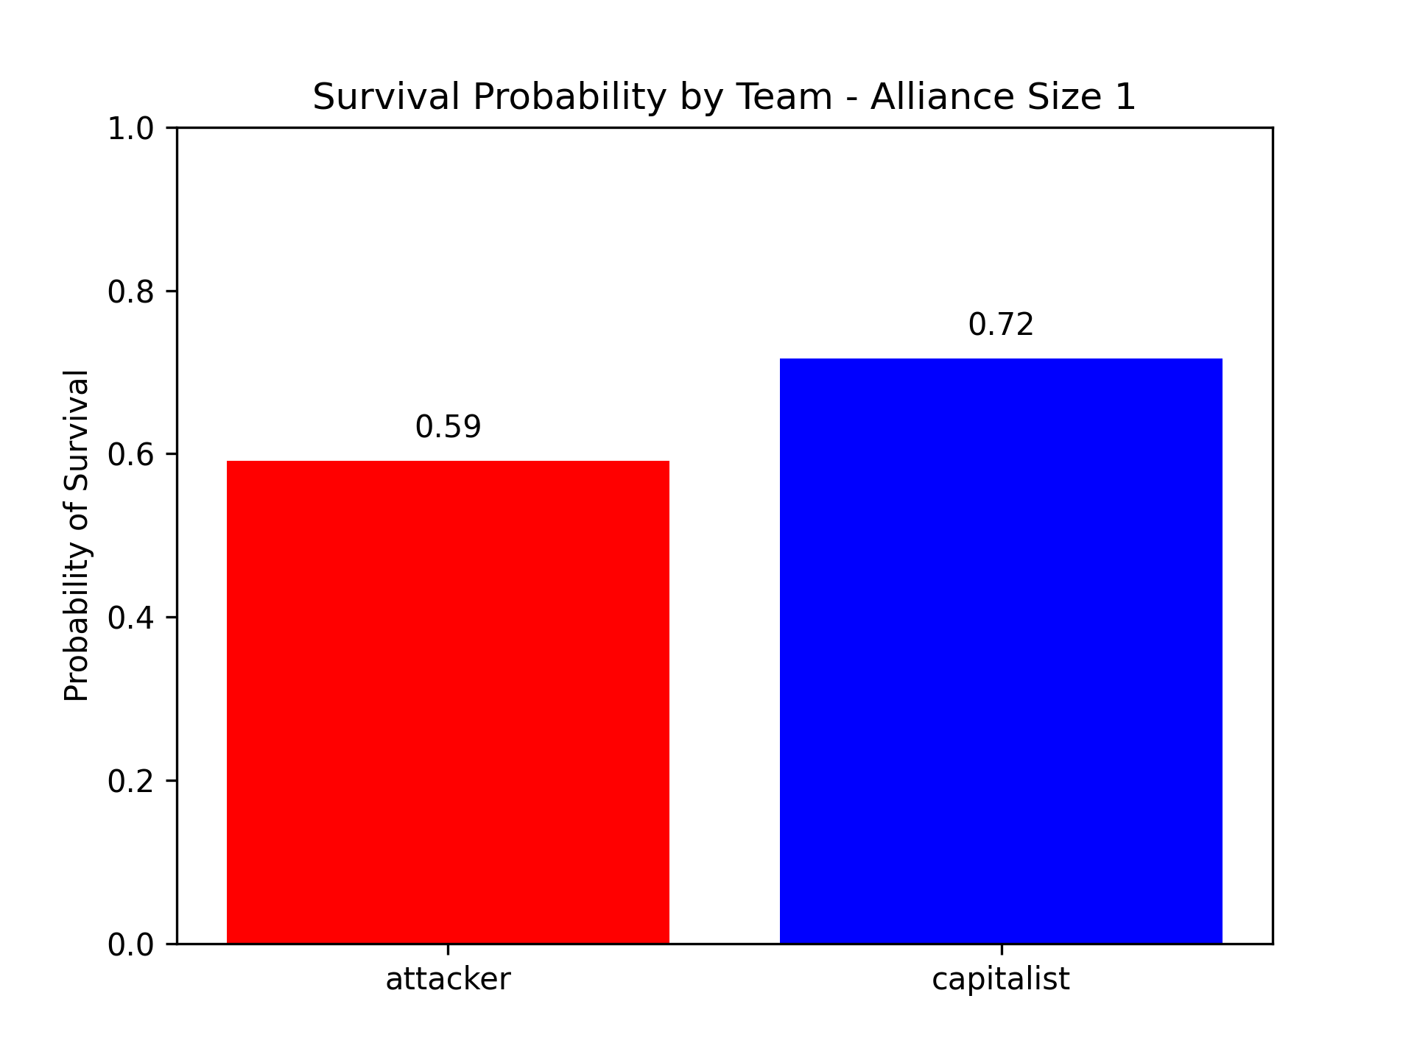
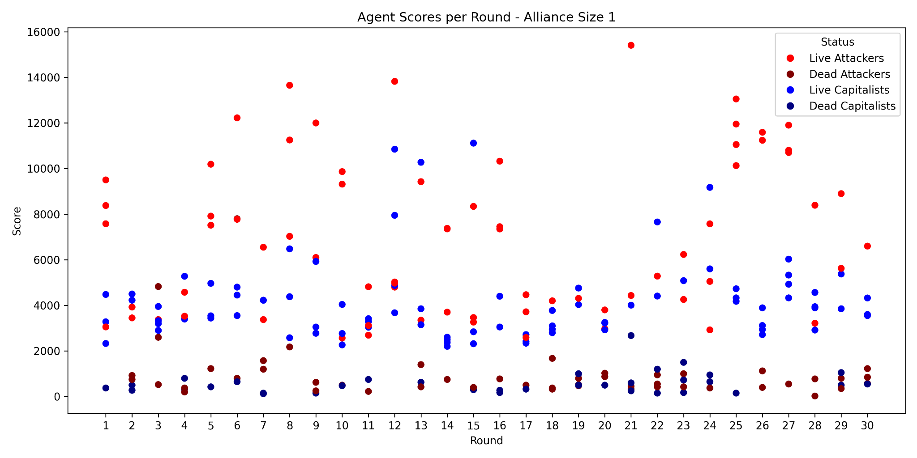
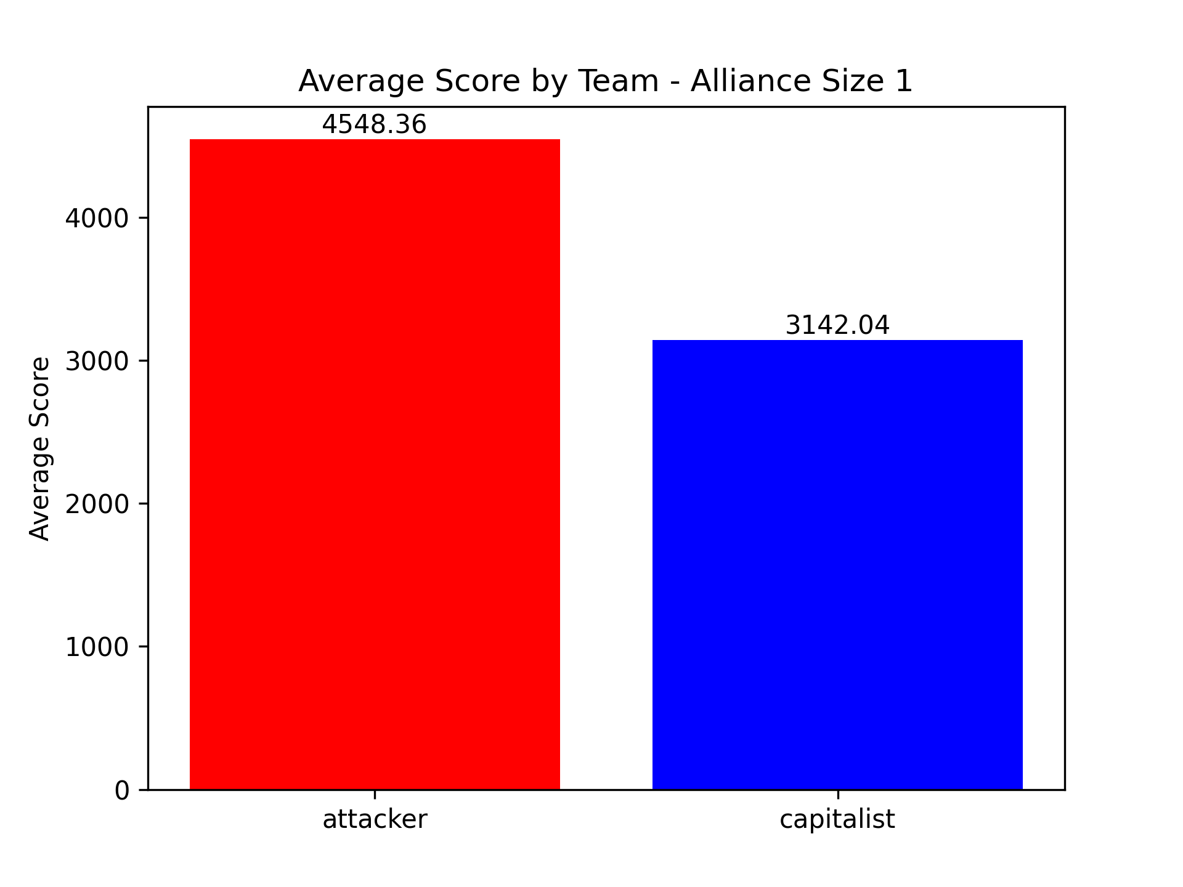
Alliance size 1

Slide 17
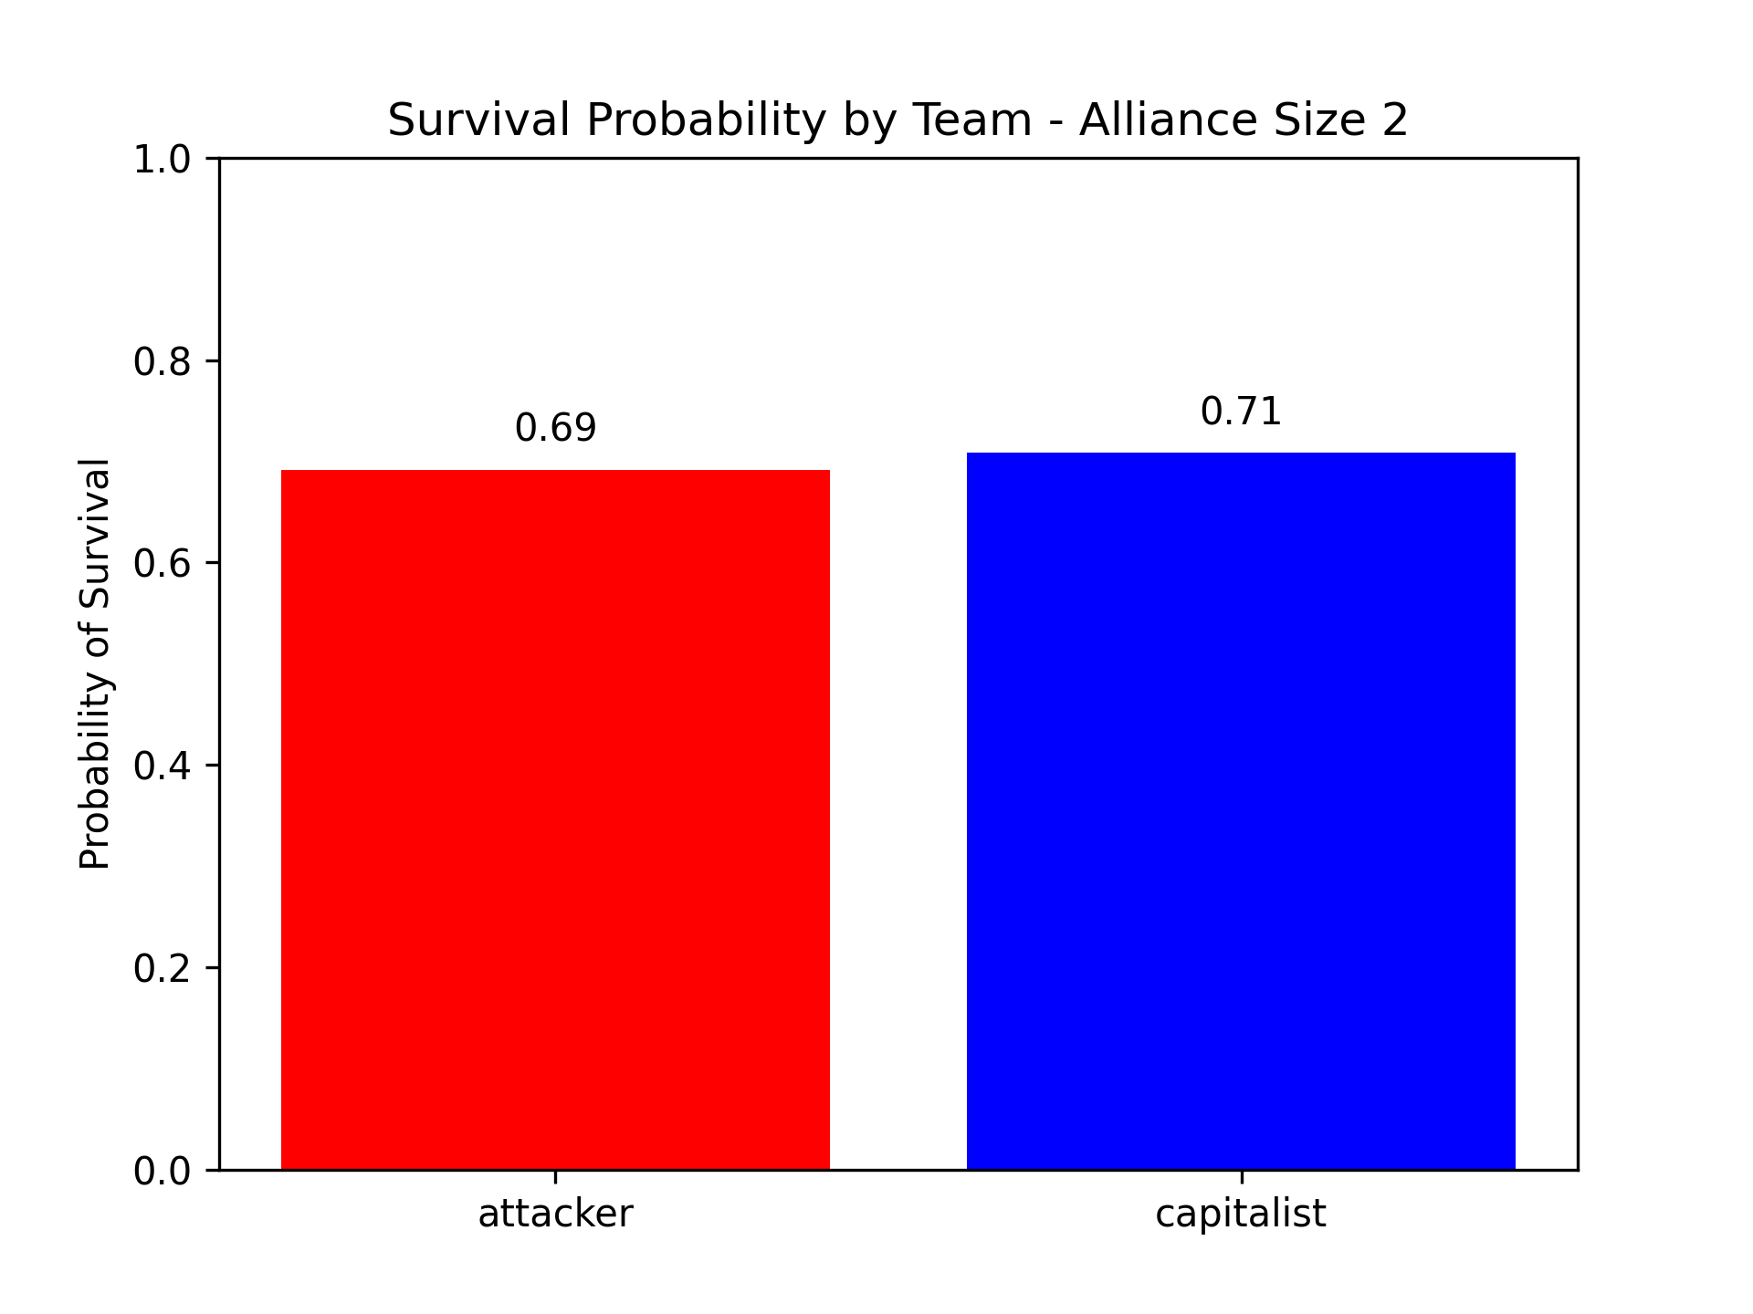
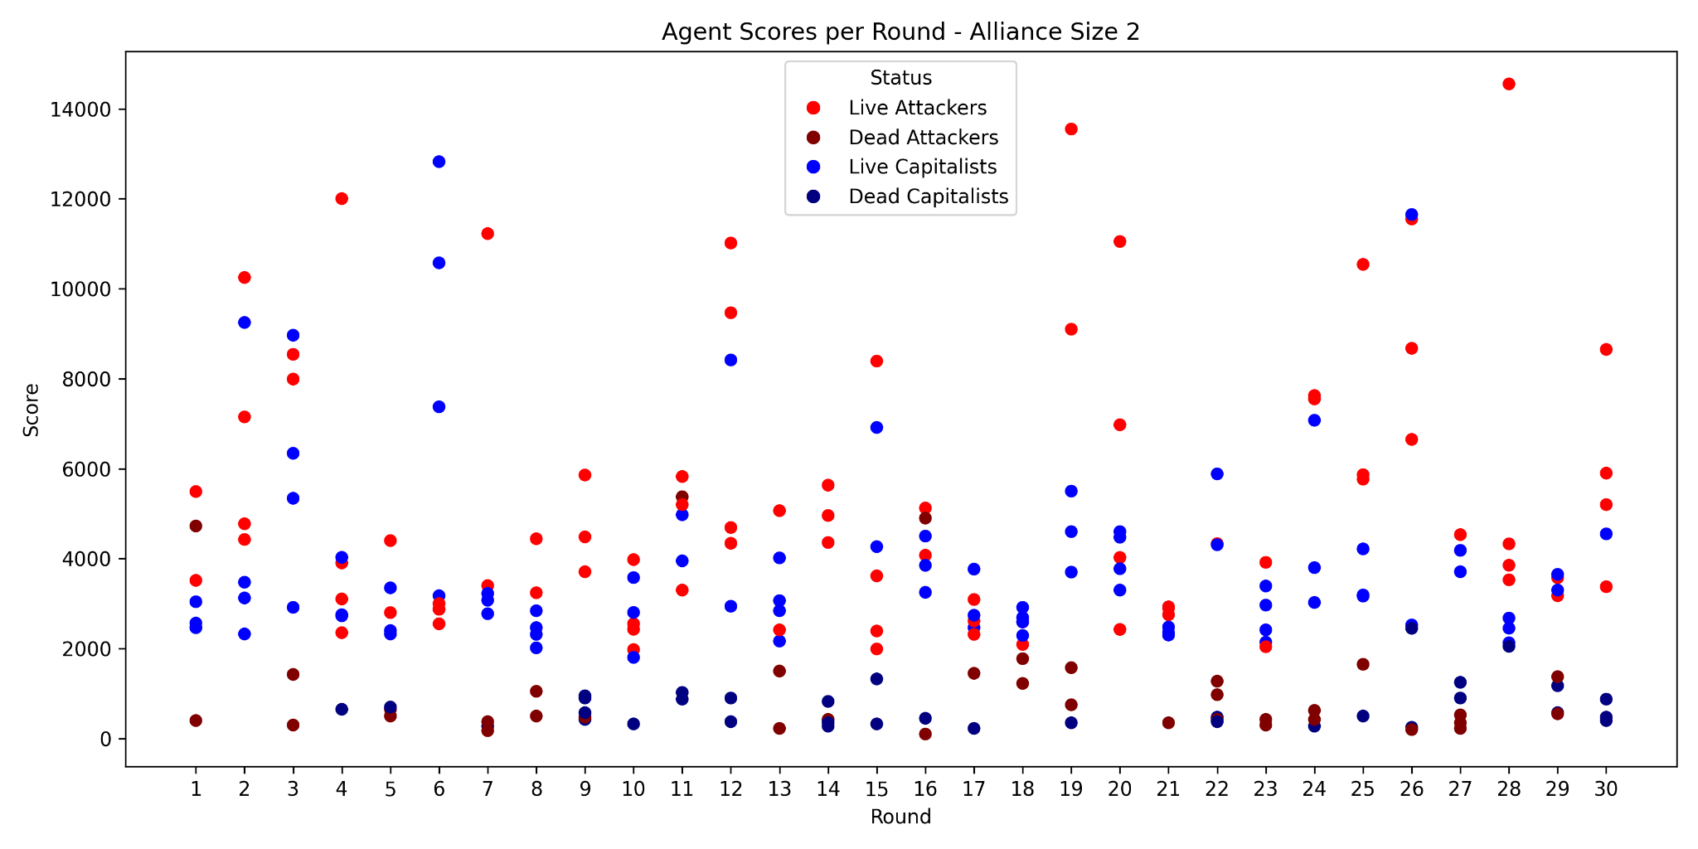
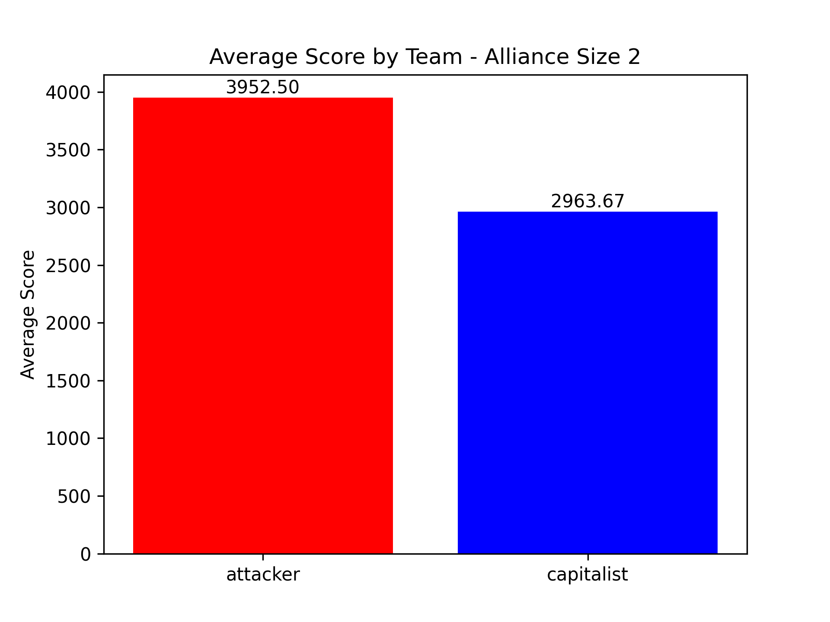
Alliance size 2

Slide 18
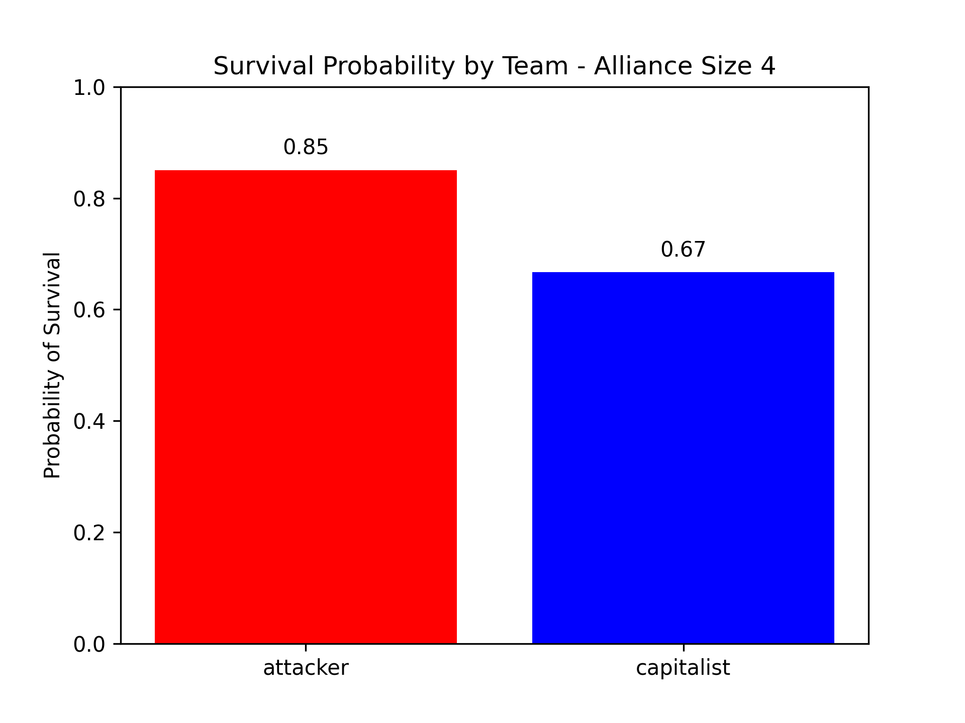
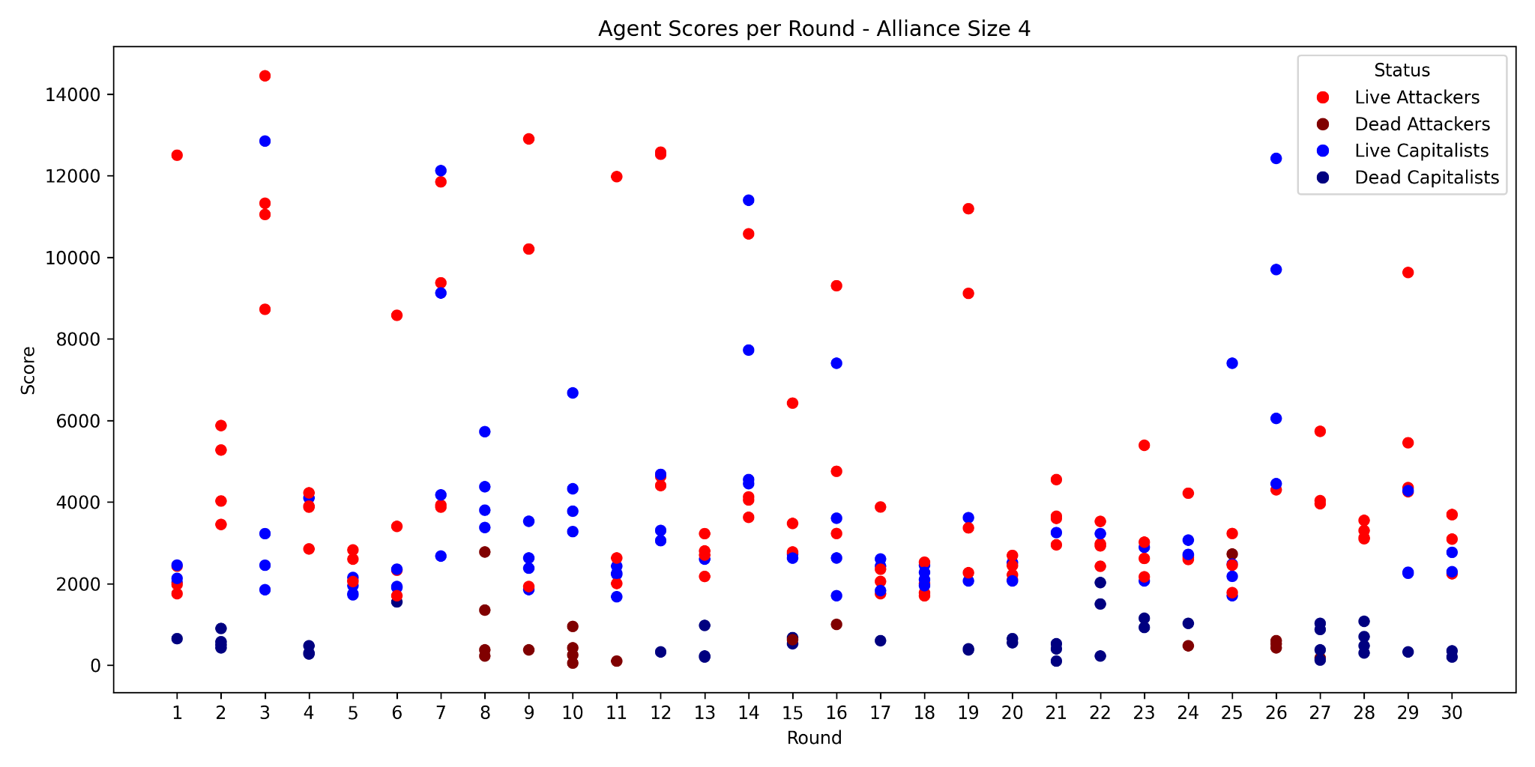

Alliance size 4

Slide 19
06
Conclusion

Slide 20

Problem Description
Overall Findings:
Jason is able to keep up with the fast paced (20 ticks/second) environment
AgentSpeak makes agent’s implementation clear and transparent
BDI leads to easy belief maintenance and plan selection for strategies
BDI/Jason should only be used for high level strategies
Notion of BDI matches closely with our understanding of mechanisms!
Strategy Findings:
Attackers are generally more successful -> invest in a lot of weapons
Being an attacker requires more allies though!
For small alliances, agents need to invest in houses but also attack a lot!

Slide 21
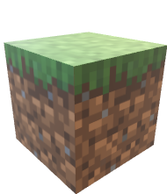
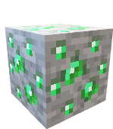


Future Work
more experiments/data collection
more complex strategies
more complex features
CompAre other paradigms

Slide 22

Thank You

